Slide 1
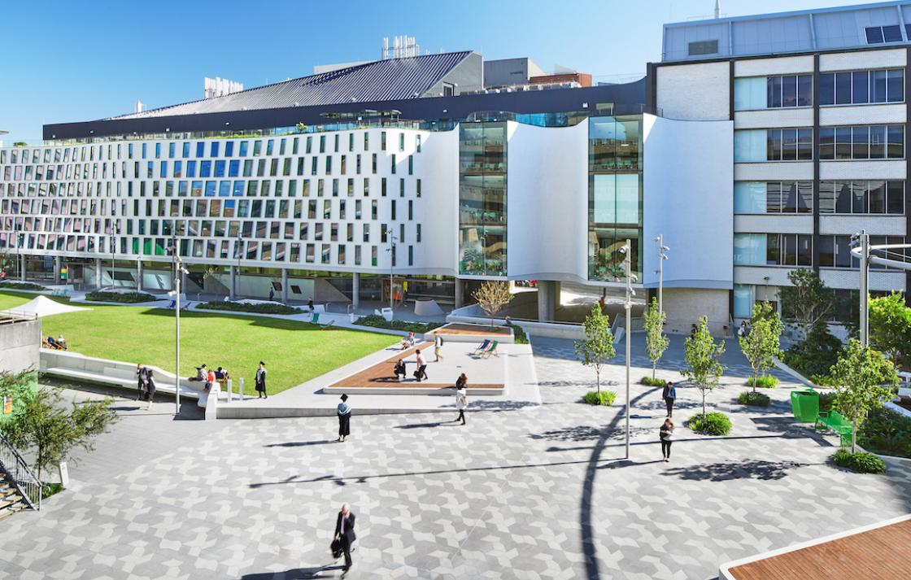
CPSU NSW UTS Members’ Meeting
Unauthorised reproduction strictly prohibited

Slide 2
CPSU NSW UTS Current Enterprise Agreement Bargaining
Current Bargaining Team:
Andreas Dalman, Mark Christopher, Rosa Bow, Daisy Amanaki, Greg Hampshire and Michael Cope
UTS Enterprise Bargaining resumed 7th February 2023.
Bargaining will conclude shortly before the single agreement is put to a vote for Union members and all UTS Staff. The single agreement will cover Professional Staff and academics.
Senior Executive Staff, UTS College staff, UTS entities staff are covered by separate agreements.

Slide 3
Key EB9 Outcomes
Single Agreement for Professional and Academic Staff
Nominal Expiry Date of EB9
Salary Offer
Leave Matters – Maximum Accumulation
Parental Leave Matters
Gender Affirmation Leave
Indigenous Matters
Superannuation
Job Security – fixed term and reduced casualisation

Slide 4
Single Agreement
The single agreement will cover Academic and Professional Staff.
Senior Executive Staff, UTS College staff, UTS entities staff are covered by separate agreements.
To be clear, the CPSU NSW and members do not want a single agreement, we want separate EAs.

Slide 5
Nominal Expiry Date of EB9

Slide 6
UTS EB9 Pay Offer
CPSU NSW UTS EB9 Log of Claims – 16% over 4 years.
UTS have rejected sign on bonus or uplifts.
The NTEU did not support uplifts but failed to propose an alternative pay increase.
Date of Pay Increase | Management Offer | CPSU NSW Offer
1 May 2023 | 2.25 | 2.25
1 November 2023 | 2.25 | 2.25
1 May 2024 | 1.75 | 1.75
1 November 2024 | 1.75 | 1.75
1 May 2025 | 1.5 | 1.5
30 September 2025 | 1.5 | 1.5 (subject to agreement on nominal expiration date)
Uplifts | rejected | HEW 1-5 $500 HEW 6-10 $1000

Slide 7
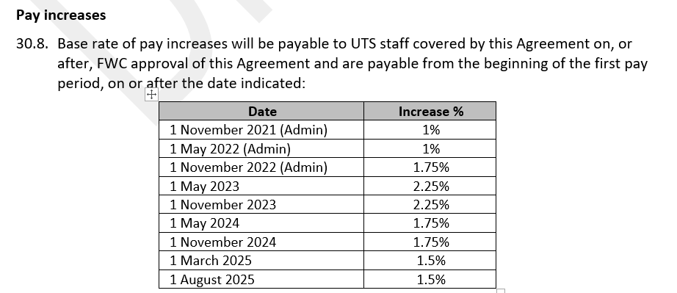
UTS EB9 Pay Offer

Slide 8
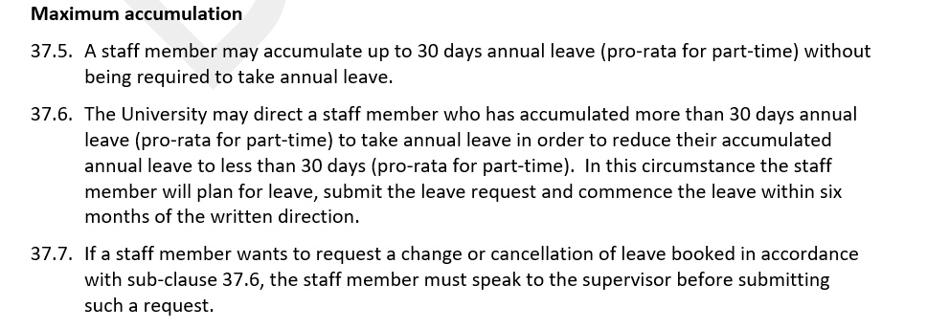
Leave Matters

Slide 9
Gender Affirmation Leave
In-principle provisional YES to change to 20 days per annum

Slide 10
UTS Indigenous Employment Target

Slide 11
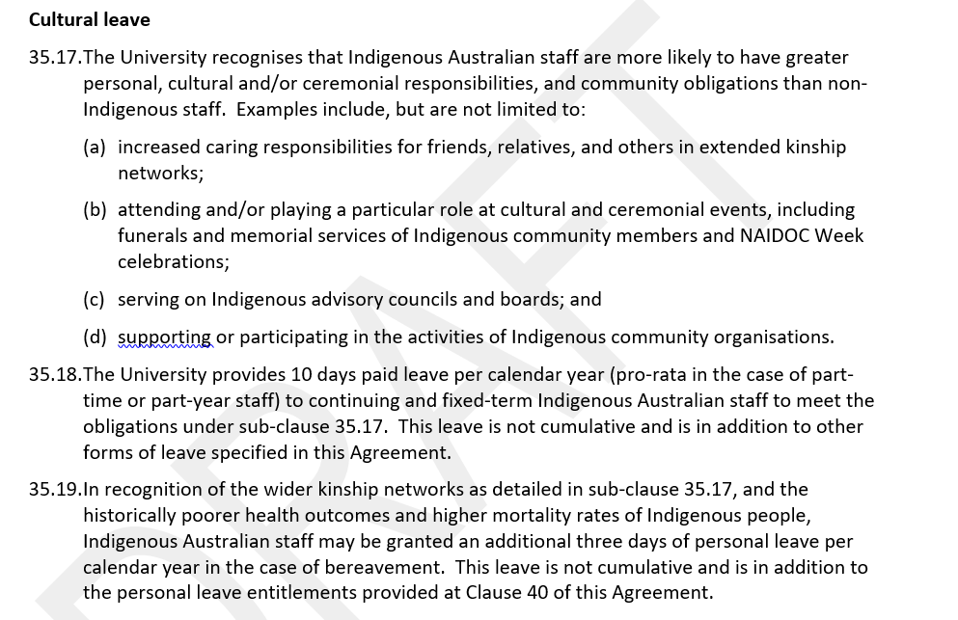
Indigenous Cultural Leave

Slide 12
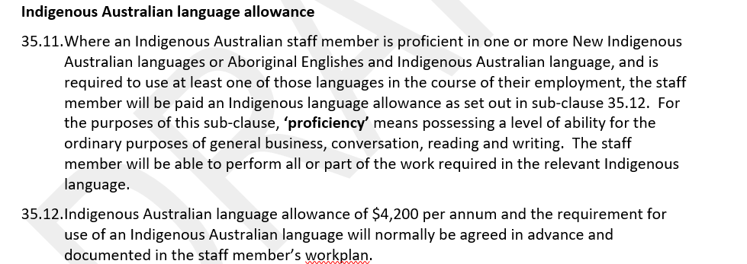
Indigenous Language Allowance

Slide 13
Extended Shutdown
Extended Closedown Period - GONE
Extended closedown periods were never an option for CPSU NSW members.
In a win for the CPSU NSW bargaining team, UTS have dropped all claim to extended closedown periods and forcing staff to take further hours from their annual leave bank.

Slide 14
Superannuation Leave
CPSU NSW claim for superannuation paid for all parental leave, in line with WSU approved EA - UTS rejected
No action to address the gender disparity gap
UTS will count unpaid parental leave as no break in continuity of service and be treated as time served

Slide 15
Individual Flexible Work Arrangement Request and Work From Home
UTS has responded to the CPSU NSW’s claims for remote working arrangements and incorporated the right to request a remote working arrangement in the individual flexible work arrangement clause.
A commitment welcomed by the CPSU NSW as per our claim, UTS management have included the ability for any informal arrangement for a remote working arrangement to be made between staff and their manager.
Other elements, including the provision of equipment and the reimbursement of costs incurred as a result of any direction by UTS to staff to work remotely as a result of any public health order have been rejected.

Slide 16
Pandemic Leave for All Staff
It is disappointing, especially now government support for leave payments due to a COVID-19 infection have been withdrawn, that UTS refuses to provide any additional pandemic leave in the event a UTS staff member cannot attend work or work remotely due to infection.
UTS have only offered 4 hour paid leave periods for all casual staff to receive a vaccination that is recommended in a public health order.

Slide 17
Union Representation
UTS have agreed to several claims to expand union representation rights including:
Secondment to unions option
Union access to staff directories
The free use of meeting rooms and their staff email addresses for communications to members
Assurances that any Professional staff member union representative attending authorised union activities under the clause will be considered on duty.
UTS have rejected any possibility of an option for the CPSU NSW to negotiate a lease agreement for an office on campus. However, this will not deter any union activity or organising at UTS. It is open to the CPSU NSW to negotiate an agreement for an office on campus.
UTS have further refused to the CPSU NSW’s claim to increase the number of paid days a union representative may be granted per year to undertake union activities.
Further amendments have been put to UTS for consideration.

Slide 18
Broadbanding
UTS has cut the current conditions of levels in broadbanding from 2-3 levels to only 2 levels.
The NTEU have remained silent on the cut. They clearly do not care about professional staff.

Slide 19
Professional Staff Development Fund
The CPSU NSW will continue to insist that the Professional Staff Development Fund will be re-inserted into the EA to make UTS’s commitments to Professional Training clear.
Currently no minimum

Slide 20
A Single Agreement is Not the Way
The CPSU NSW UTS bargaining team remain strongly committed to professional staff issues in a separate Professional Staff enterprise agreement as raised in our members’ Log of Claims.
UTS’s unfortunate pursual of a single enterprise agreement for both Professional and academic staff has been wrought with difficulties and delayed the settlement of an agreement for Professional Staff.
This problem is endemic at university sights that bargain for a single agreement. It creates conflicts of interests and delays professional staff from receiving their benefits in a fair and equitable manner.
We can only hope that UTS has learned from this unpleasant experience.

Slide 21
CPSU NSW UTS
https://cpsunsw.org.au/category/agencies/nsw-universities/university-of-technology-sydney/

Slide 22
Where to Now?
The end is in sight.
Next Meeting:
Tuesday 21 February
Indigenous employment provisions (Clause 35)
Annual leave (Clause 37)
Gender affirmation (Clause 41)
Professional Development Fund (Clause 80)
Contract Research Employment (Clause 29)
Casual academic activity descriptors (Schedule 2)

Slide 23
Next Steps
In-Principle Agreement to EB9 after members’ consultation.
Final Drafting of the Single Agreement
Presentation to University Community
Union/All Staff Vote
Registration of UTS EB9 with the Fair Work Commission
Approved by the Fair Work Commission
Implementation Meetings during life of agreement.

